Slide 1

知識管理的評比指標(MAKE)
1.整體知識計劃的品質
2.高層對知識管理的支持度
3.對技術革新的貢獻度
4.促進知識資產最大化的措施
5.知識共享活動的效果
6.持續學習的文化的滲透度
7.創造顧客價值及忠誠度
8.對股東權益報酬的貢獻度
「年度最佳知識應用企業獎」(Most Admired Knowledge Enterprises) ，是由全球知名KM獨立研究企業Teleos及致力於從事最佳知識應用評估與分享之KNOWNetwork聯合主辦，2001年為第四屆。在2001年度最佳知識應用企業獎評審時，共有120家知名企業入圍;其中37家在決賽中出線，最後由「專家評審小組」甄選出前20名最佳知識應用企業。

Slide 2
2000年度全球最佳知識應用企業獎(MAKE)
資料來源：Teleos – The KNOW Network, 2000 Most Admired Knowledge Enterprises

Slide 3
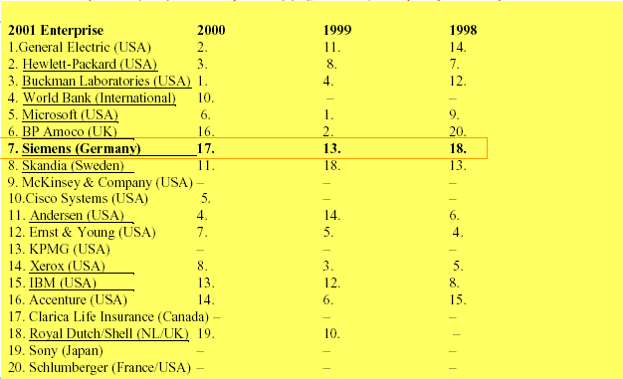

2001年度全球最佳知識應用企業獎(MAKE)

Slide 4
MAKE評比項目演變
2001 | 2002 | 2003
Success in establishing an enterprise knowledge culture | Creating a corporate knowledge culture | Creating a corporate knowledge-driven culture
Top management support for managing knowledge | Developing knowledge leaders | Developing knowledge workers through senior management leadership
Ability to develop and deliver knowledge-based goods/services | Delivering knowledge-based products/services/solutions | Delivering knowledge-based products/solutions
Success in maximizing the value of the enterprise’s intellectual capital | Maximizing enterprise intellectual capital | Maximizing enterprise intellectual capital
Effectiveness in creating an environment of knowledge sharing | Creating an environment for collaborative knowledge sharing | Creating an environment for collaborative knowledge sharing
Success in establishing a culture of continuous learning | Creating a learning organization | Creating a learning organization
Effectiveness of managing customer knowledge to increase loyalty/value | Focusing on customer knowledge | Delivering value based on customer knowledge
Ability to manage knowledge to generate shareholder value | Transforming knowledge into shareholder value | Transforming enterprise knowledge into shareholder value
資料來源：陳永隆

